Slide 1
Vāgyojaka
Prof. Ganesh Ramakrishnan
Prof. Preethi Jyothi
Computer Science and Engineering Dept.
IIT Bombay
Computer Science and Engineering Dept.
IIT Bombay
Rishabh Kumar, Devaraj Adiga, …
Vāgyojaka @ IITB

Slide 3
Table of contents
01
02
03
04
Introduction
Features
Demo
Roadmap
Vāgyojaka @ IITB

Slide 4
Vāgyojaka
</.>
Offline Tool
Web Portal
Models
Vāgyojaka @ IITB

Slide 5
Features of Vāgyojaka
01
02
03
Transcript
Translation
Speech-to-speech Translation
Vāgyojaka @ IITB

Slide 6
Features of Vāgyojaka
04
05
Text-to-speech
Video-to-video Translation
Vāgyojaka @ IITB

Slide 7
Demo
Vāgyojaka @ IITB

Slide 8
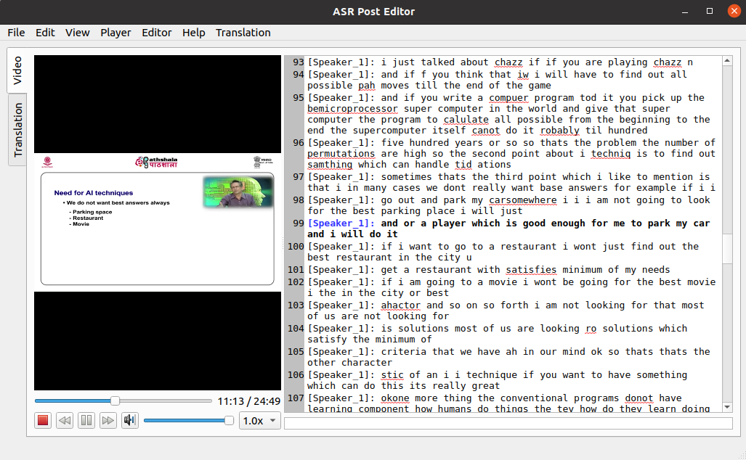
Vāgyojaka: Offline Tool
Offline Tool:
Easy to use User Interface
Video/Audio-transcript
alignment using timestamps
Speaker database
Error detection
Fixed dictionary word suggestion
Log: edits tracking
Audio features capturing
Multiple Language Support

Slide 9
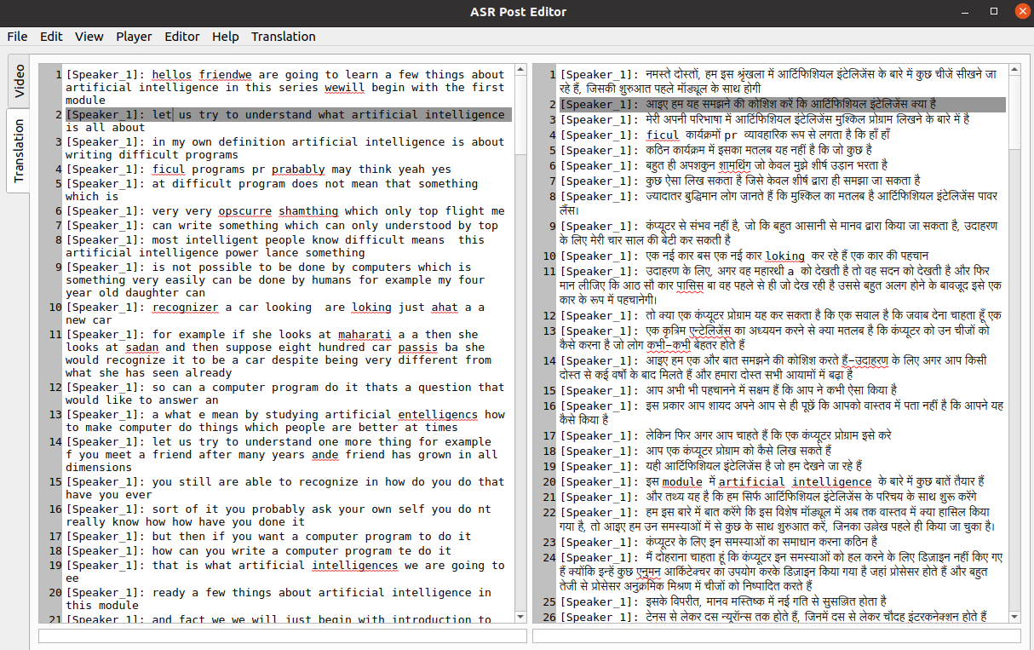
Vāgyojaka: Offline Tool
Offline Tool:
9. Multi-language translation editing

Slide 10
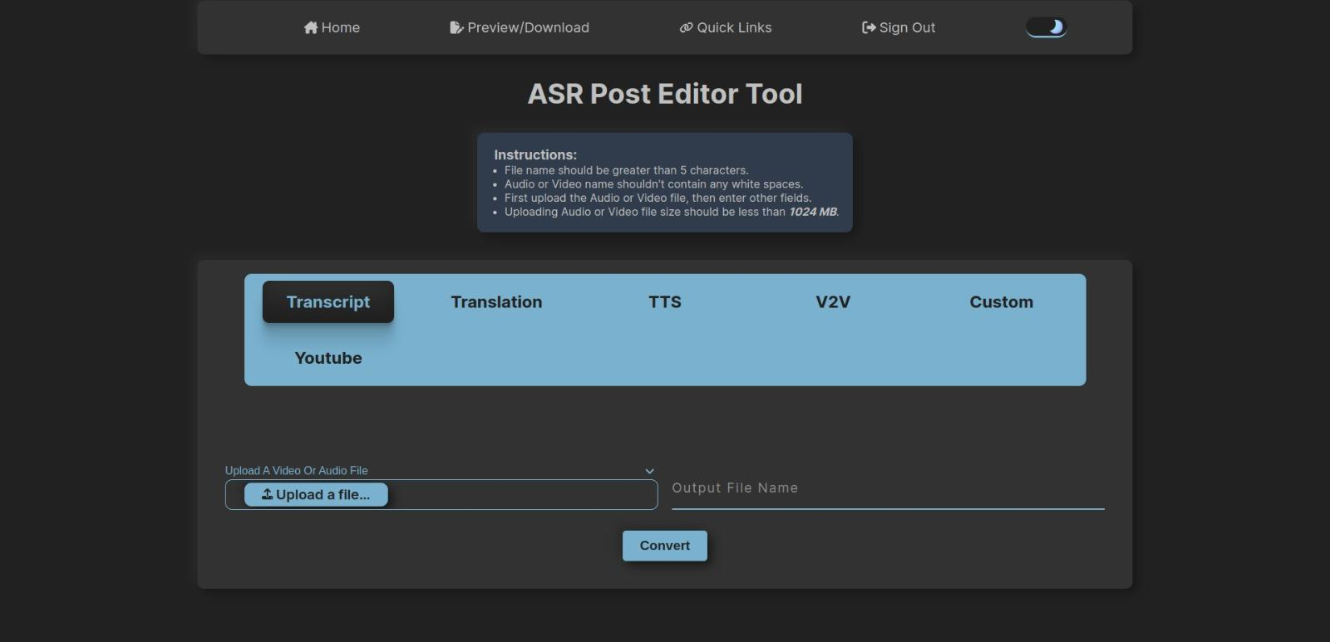
Vāgyojaka: Web Portal
Web Portal:
Audio/Video transcript creation
Text transcript to translation creation
Video to Video translation
Text to Speech

Slide 11
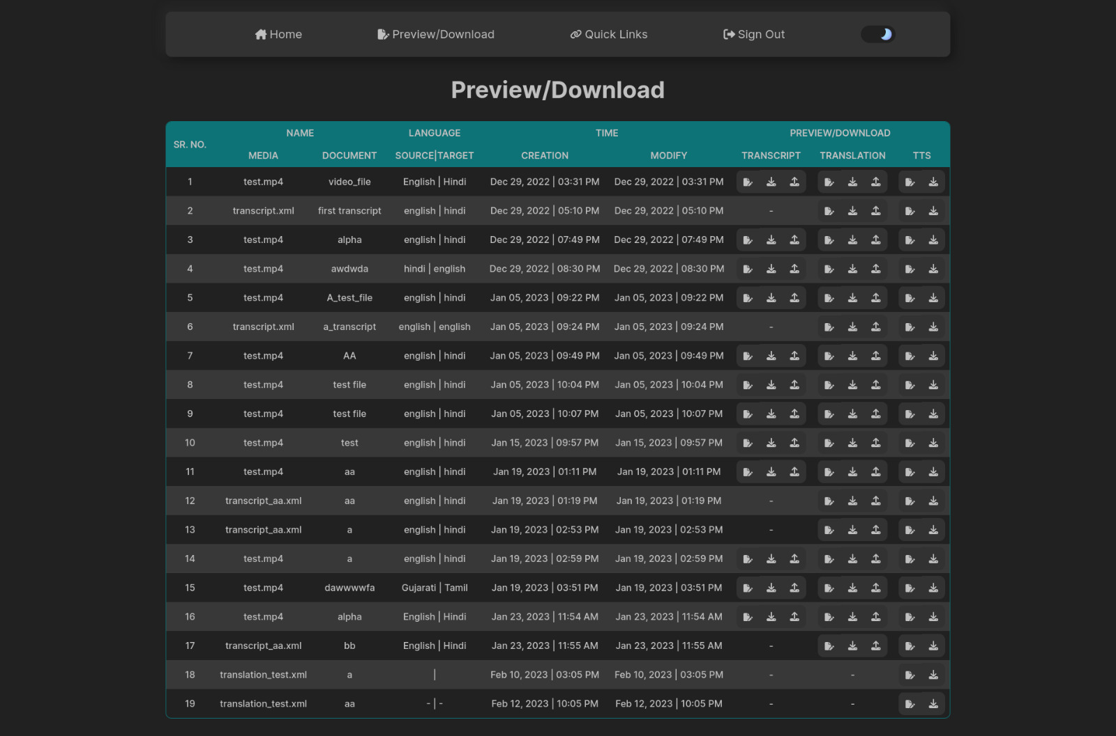
Vāgyojaka: Web Portal (Dashboard)
Web Portal:
5. Workflow Management

Slide 12

Roadmap
Vāgyojaka @ IITB

Slide 13
Vāgyojaka: roadmap ahead
AI Auto Suggestion
Error Detection
Log: Edits Tracking
Youtube Integration
Speaker Identification
Manual Editing Transcription
Manual Editing Translation
Easy to use UI
Audio Transcript
Video-to-Video Translation
Math equation retrieval from Video
Capturing Audio Features
Video Transcript
Text, Slides Translation
Slides retrieval from Video
EXISTING FEATURES
FUTURE FEATURES

Slide 14
Sanskrit ASR Results
System | Dev | Test | |Test|*
VakASR-Word | 35.68 | 42.52 | 32.22
VakASR-BPE | 18.62 | 23.49 | 18.79
wav2vec2.0 | 16.62 | 20.17 | 17.11
MorphASR-NBest-EBM | 17.80 | 22.41 | 18.5
MorphASR-WCN_{Exh}-morphLM | 16.18 | 20.26 | 17.91
MorphASR-WCN_{Exh}-EBM | 14.15 | 16.31 | 13.7
MorphASR-WCN_{Cpt}-EBM | 11.53 | 12.54 | 9.89
*WER = Word Error Rate

Slide 15
Hindi ASR Results
System | Google/Fleurs Test set | GramVaani ASR Corpus Test
Whisper Hindi | 6.8 | 10.98
Wav2vec2 Hindi | - | 19
IndicWav2vec Hindi

Slide 16

Original Lecture

Slide 17

Hindi Lecture

